Slide 1

Diffusion Models
22-808: Generative models Sharif University of Technology Fall 2024
Fatemeh Seyyedsalehi

Slide 2
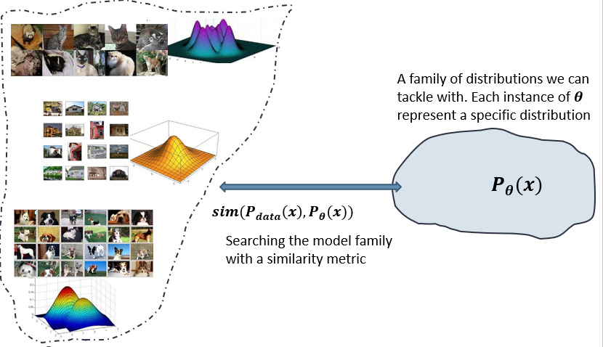
Recap
We need a framework to interact with distributions for statistical generative models.
Probabilistic generative models
Deep generative models
Autoregressive models
Variational Autoencoders
Generative adversarial networks
Normalizing Flow
Energy-based models
Score-based models
Diffusion models Finally the last one ☺ what is the next ?

Slide 3
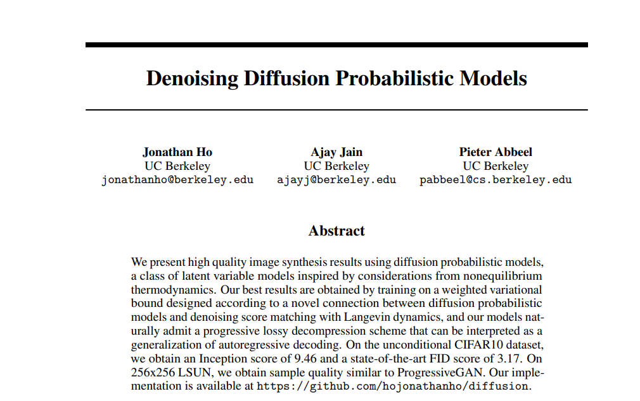
DDPM paper
The main idea behind DALLE-2, stable diffusion ☺

Slide 4
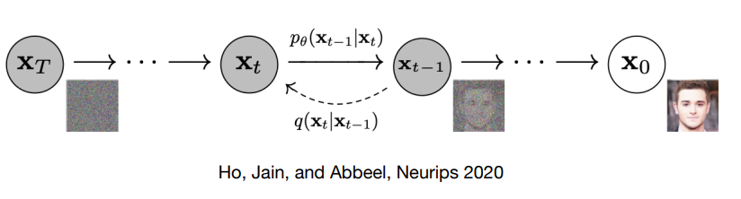
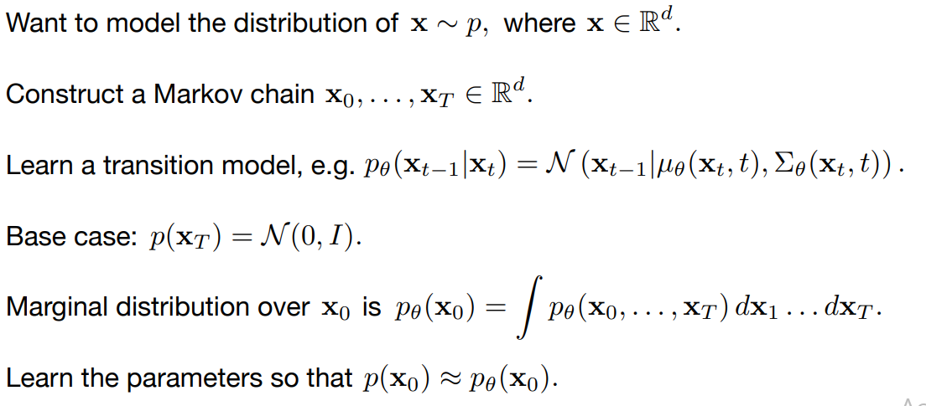
Diffusion models

Slide 5
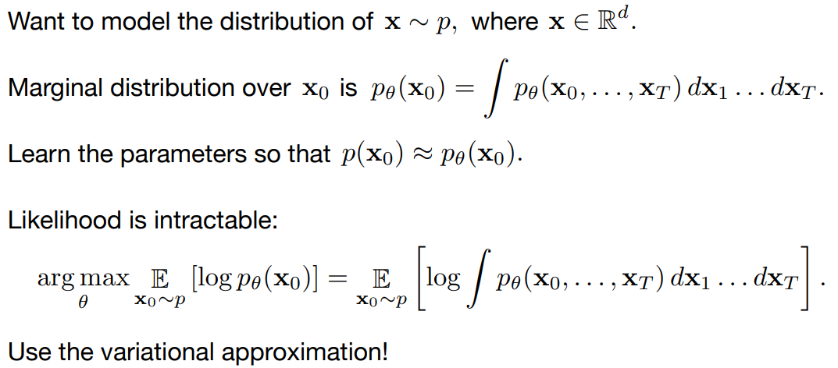
Diffusion models Maximize the likelihood?

Slide 6
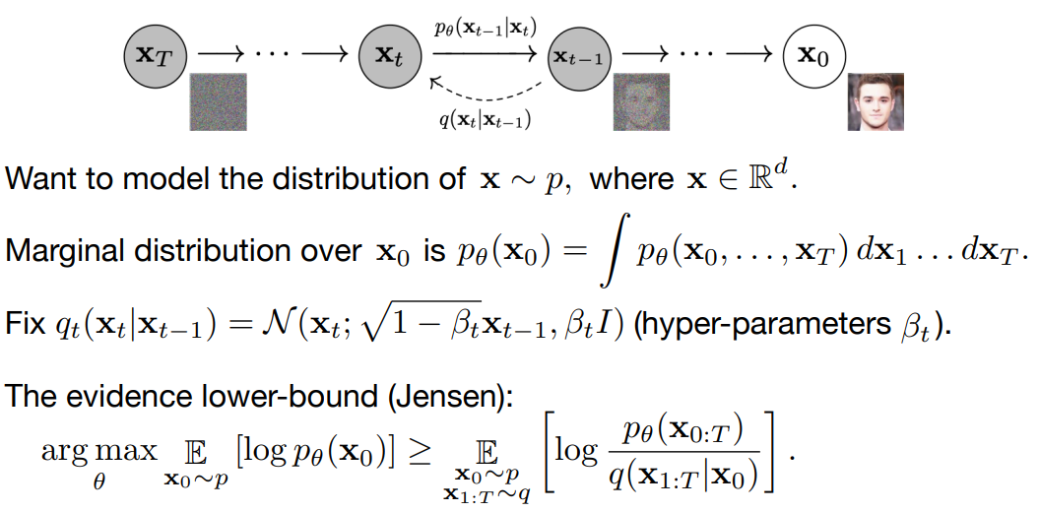
Diffusion models Using ELBO

Slide 7
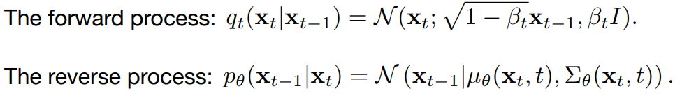
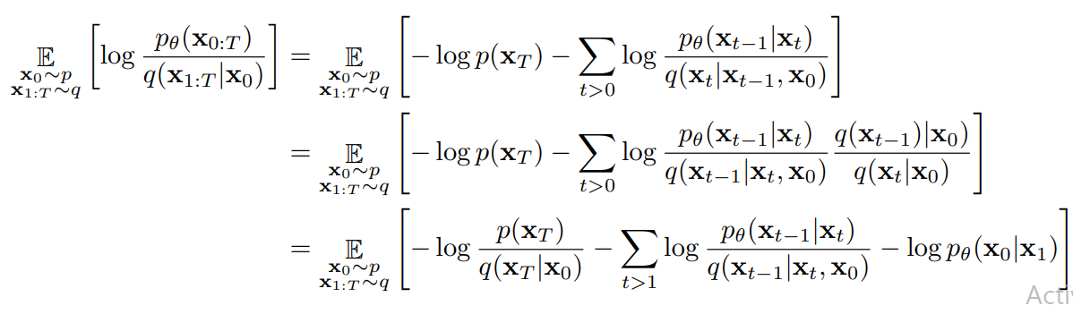
Diffusion models Using ELBO

Slide 8
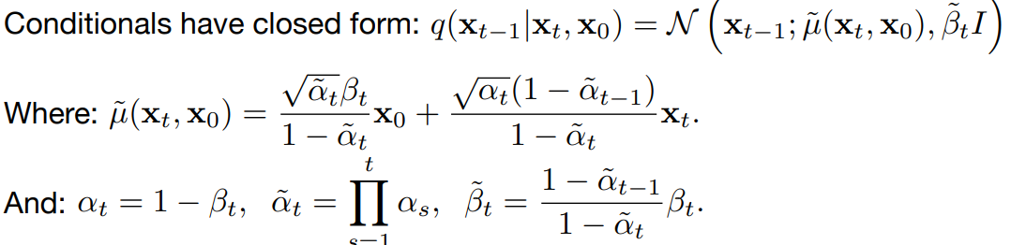
Diffusion models Using ELBO

Slide 9
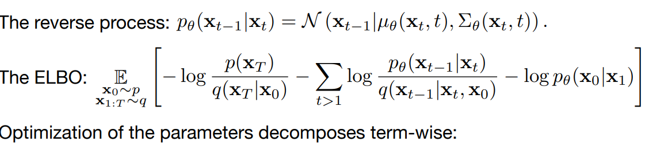
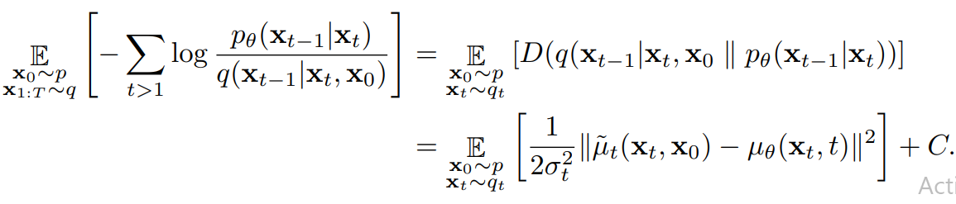
Diffusion models Unpack the ELBO

Slide 10
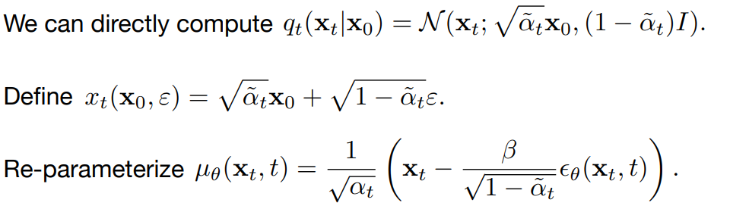
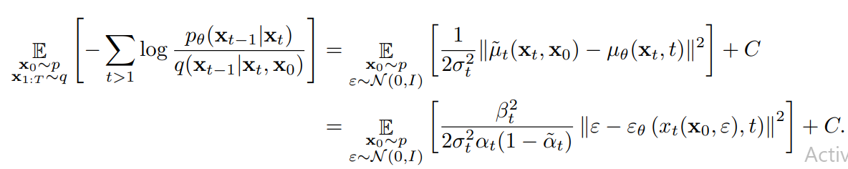
Reparameterization

Slide 11
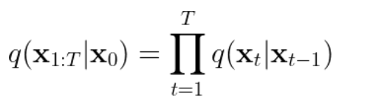
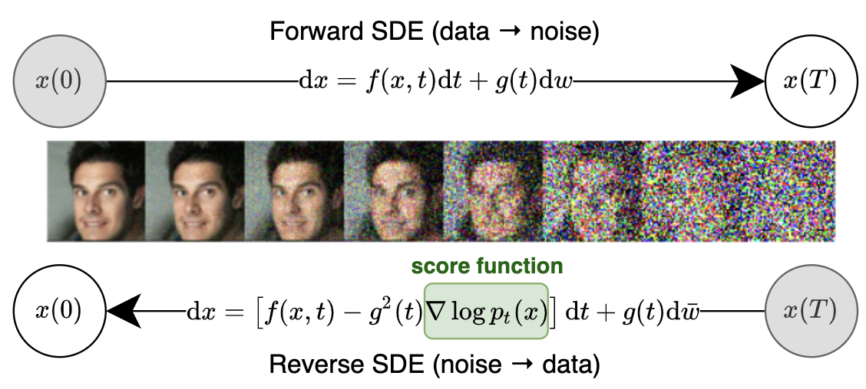
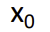
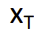
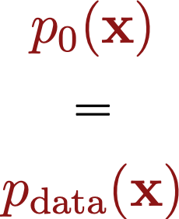
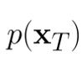
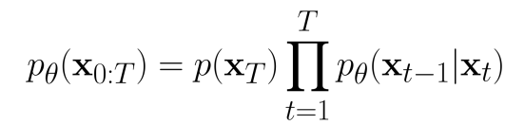
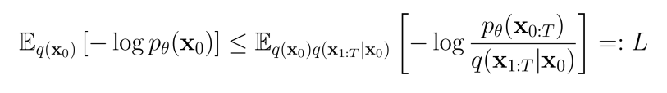
Denoising diffusion probabilistic model
Encoder (q) has no learnable parameters!
Encoder (fixed):
q
Decoder:
ELBO loss (negative ELBO averaged over data distribution):
Notes:
The method can be further generalized to an infinite number of noise scales. Here the noise perturbation becomes a diffusion process that perturbs data with continuously increasing intensity through time.
This diffusion process can be described as a solution to an SDE, namely a stochastic differential equation. By reversing this diffusion process, we can generate samples from random noise.
Crucially, the reverse diffusion process can be obtained by solving a reverse-time SDE, and we can derive this reverse-time SDE once we have the score of the distribution at each intermediate time step is known. Similarly to the case with finite noise scales, we can learn this time-dependent score by training a time-depedent score network with a continuous mixture of score matching objectives.

Slide 12
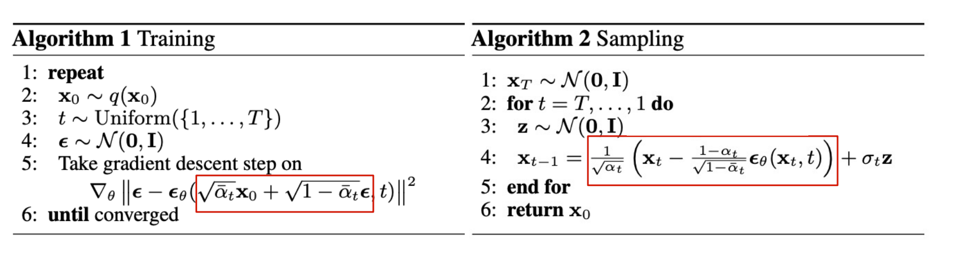
Training and inference
Denoising score matching training
Iteratively Sample from decoders
(Annealead Langevin Dynamics)

Slide 13
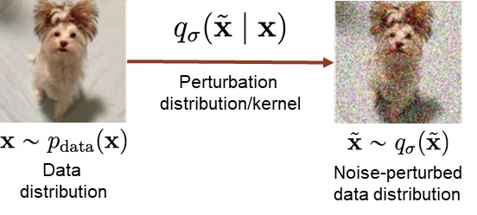


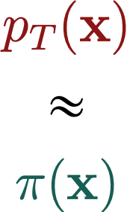
Diffusion perspective
q
q

Slide 14

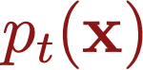

Infinite noise levels

Slide 15
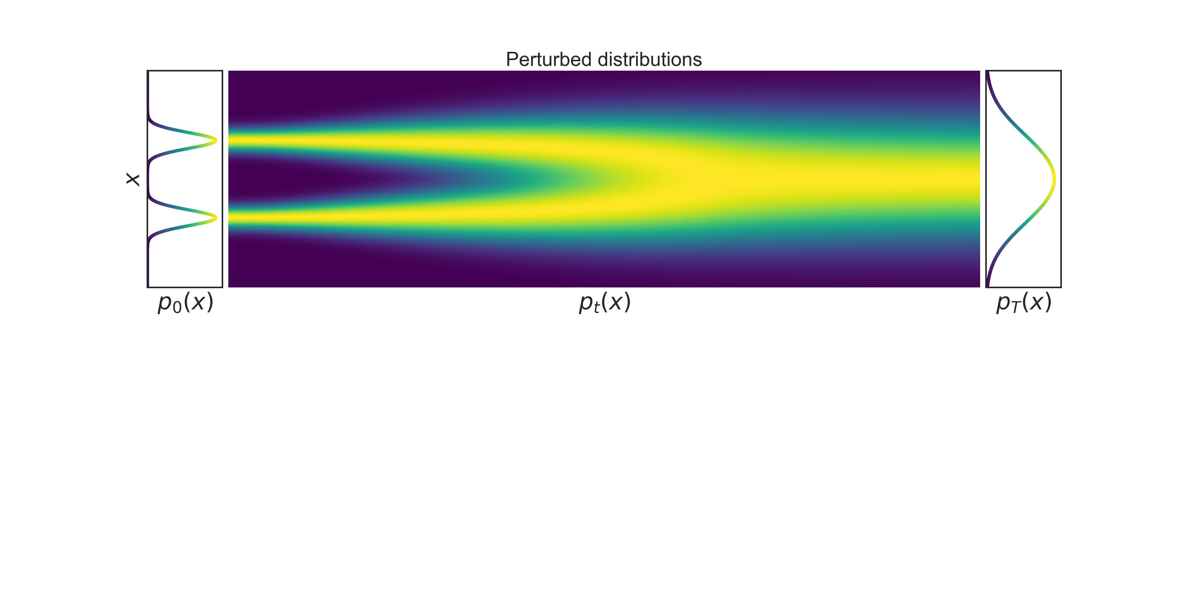
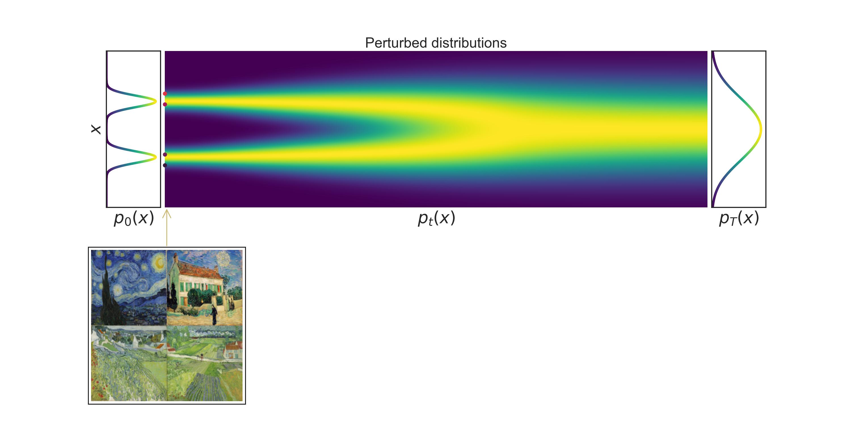
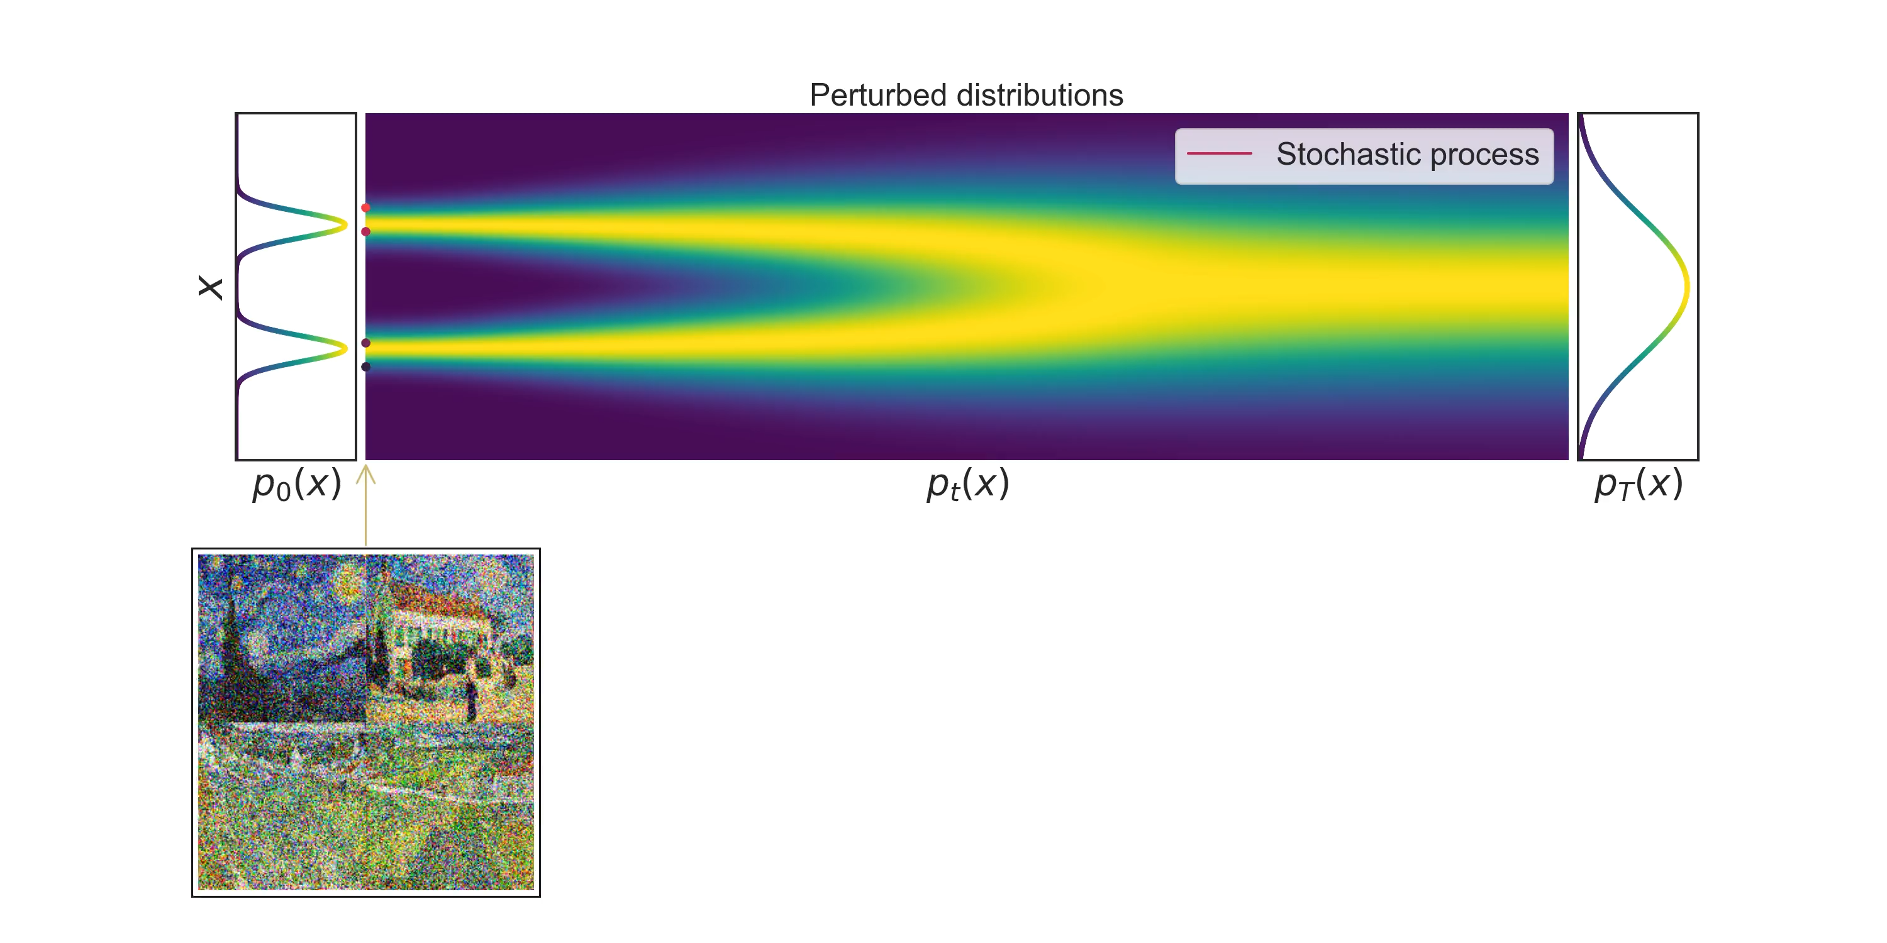
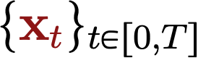
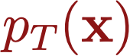
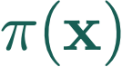
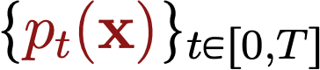
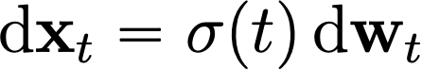
Perturbing data with stochastic processes
Score Matching and Denoising Diffusions can be viewed as discretization of the continuous SDE dynamics.
Stochastic process
Stochastic differential equation (SDE)
Deterministic drift
Infinitesimal noise
Probability densities
WLOG: Toy SDE

